Slide 1
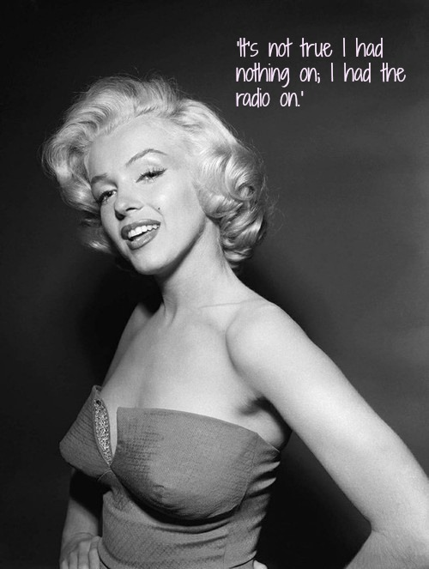
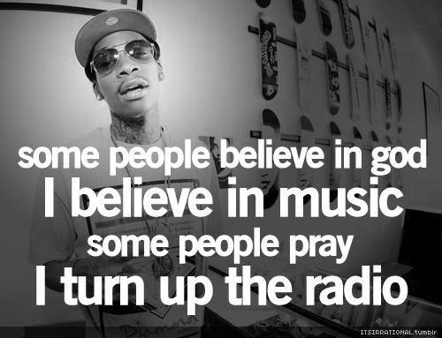
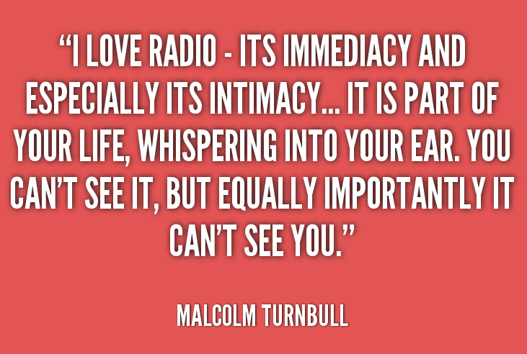
Journal Entry
Use one of these quotes to inspire the focus of your journal entry today.

Slide 2
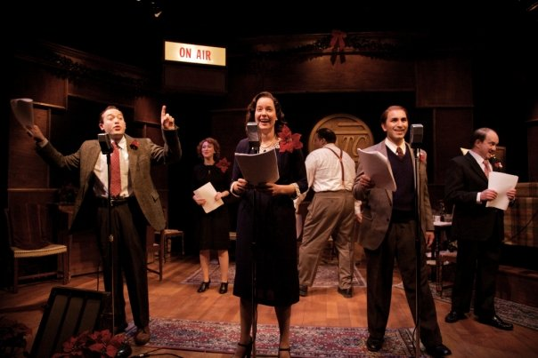
Radio Plays

Slide 3
What is a Radio Play?
Radio plays are dramatized, purely acoustic performance, broadcast on radio or published using audio media (such as tape, CD, mp3, etc.)
With no visual component, these dramas depends on dialogue, music, and sound effects to help the listener imagine the characters and story
Radio plays achieved widespread popularity within a decade of its initial development in the 1920s.
By the 1940s, it was a leading international popular entertainment.
With the advent of television in the 1950s, radio dramas lost some of their popularity; however, in some countries such dramas still retain large audiences

Slide 4
Examples
Here are two examples, taken from A Prairie Home Companion, which is a comedic Minnesota radio program that features music and mini-radio plays.
Here is one: P.O.E.M.
Note its formatting: this is how you’ll eventually be expected to format your radio plays
Here is another example: Rhubarb
This one focuses on the skills of the individuals who make the sound effect and who do the musical interludes: it’s not just about dialogue
This is a student example from a few years past: Dusty
This one follows similar expectations to what you will have
Notes:
Videos are about 12 minutes total

Slide 5
Your Task
In your groups, which have been assigned to by Mrs. Lyke, create and record your own original radio play. Use the BBC’s “How to Write a Radio Play” to help you and use A Prairie Home Companion’s “P.O.E.M.” script as a formatting guide.
Expectations:
Students will work together; each playing an equal role in both the writing of the script as well as the recording of it
Each play must have at least five characters and incorporate sound effects (ideally some music as well)
Each play must fit into the allotted air time: 7-8 minutes
Adding a short (30 seconds or fewer) “commercial” or two is optional
Each play must connect to the following topic: high school
Notes:
Videos are about 12 minutes total

Slide 6
The Timeline
Date(s) | Activity
5.4, 5.5, 5.8 & 5.9 | In class work days (if emailing the audio portion of the play to Rogers, it must be done by 9:00 PM on the 2nd: email to norogers@isd535.org)
5.10 | All Radio Plays Due Share with the class Turn in the script Complete a self/peer evaluation
Notes:
Videos are about 12 minutes total

Slide 7
Here is a website full of examples

