Slide 1
Animal Stories
After each clip, make a list of the characteristics in each of the stories.

Slide 2
Ferdinand

Slide 3
The Biggest Bear

Slide 4
Bambi

Slide 5
The Incredible Journey

Slide 6
The Yearling

Slide 7
Charlotte’s Web

Slide 8
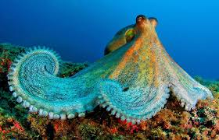
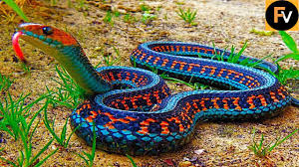
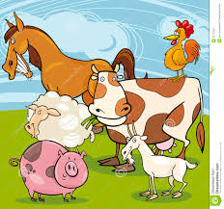
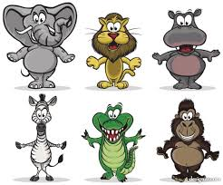
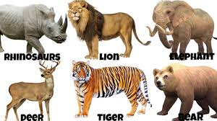
Discuss
Turn and talk about the characteristics you found.
Discuss whole class
Make a list of animals you find interesting; this could include insects, birds, fish..

